Slide 1

Helping You Reach Out to Your Book Loving Customers Better
PROJECT - 01

Slide 2


Group Members
Norma Espinosa
Laleh Safarzadeh
Kristen Wilder
Angele Yazbec

Slide 3

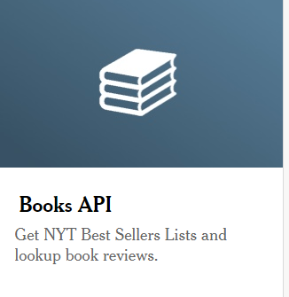
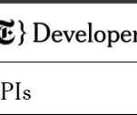
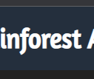
Data to be used:
New York Times Books API
- Obtain bestsellers
Rainforest API—Amazon Product API

Slide 4
Research Questions
Preference for printed, e-books, audiobook (sales numbers for both) on Amazon?
Summary statistics and bar chart/pie chart
What are the price differences for Kindle versus printed copy on Amazon? Summary statistics and bar chart
Scatter plot with regression line
Which category of book is most popular (adult nonfiction or adult fiction)? Summary statistics and bar chart/pie chart
What is the rating for the top five books and their authors?
What is the price average per category?
Category with more ratings/sales?
What is the rating average per category?

Slide 5

Task Outline
Task 1: Mine data from New York Times Book API, clean data, create csv
Task 2: Mine data from Rainforest API, clean data, add to csv
Task 3: Exploratory data analysis
Task 4: Visualizations
Presentation/PowerPoint
Write-Up Summarizing Finding

Slide 6
Task Division
Laleh—New York Times API data mining, cleaning using Pandas, create CSV file, help with summary and PPT
Angele—Rainforest API data mining, cleaning using Pandas, merge with prior CSV file and clean, write-up summarizing major findings, assist with PPT
Norma—For some of the research questions: conduct exploratory data analyses with Pandas, data visualizations (Pandas and/or matplotlib), assemble PowerPoint and add visuals
Kristen— For some of the research questions: conduct exploratory data analyses with Pandas, data visualizations (Pandas and/or matplotlib), assist with PowerPoint and add visuals, assist with summary
Swapnali— For some research questions: conduct exploratory data analyses with Pandas, data visualizations (Pandas and/or matplotlib), assist with reviewing PPT and summary

Slide 7


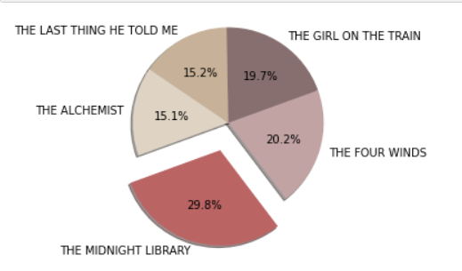



What are the rating for the top five authors and their books?

Slide 8
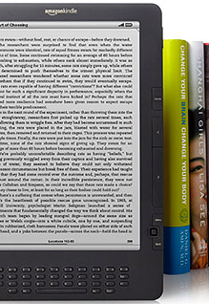

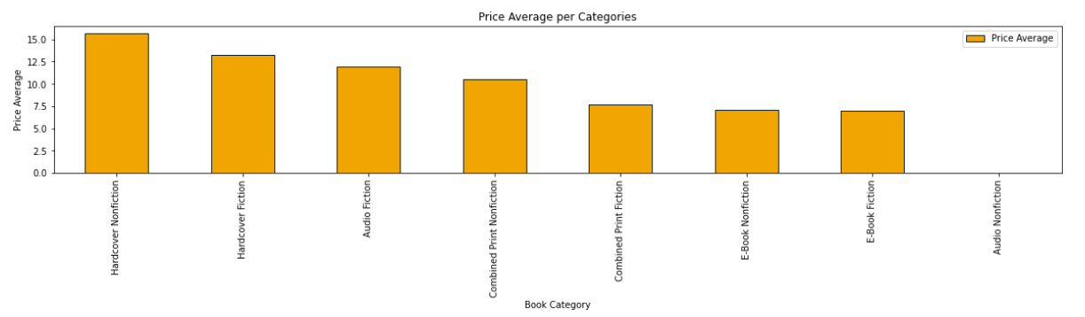
What is the price average per category? The Hardcover Nonfiction has highest price…

Slide 9

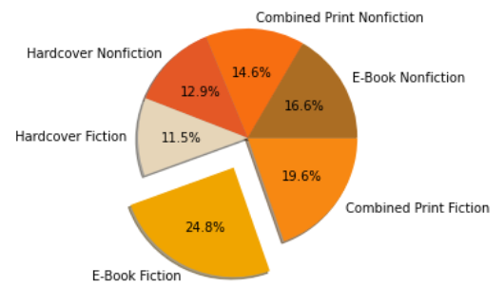

Category with more ratings/sales:

Slide 10

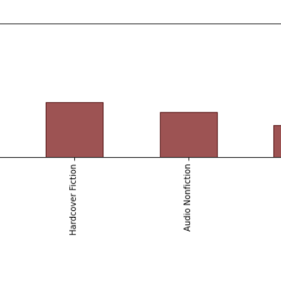

What is the rating average per category? Audio Fiction has more ratings than the rest of the categories

Slide 12



Slide 13
